Slide 1

LINFO2992 - TFE
Hasan Bilgin (0446-22-00)
Ruibin Zhang (0660-22-00)
2023-2024

Slide 2
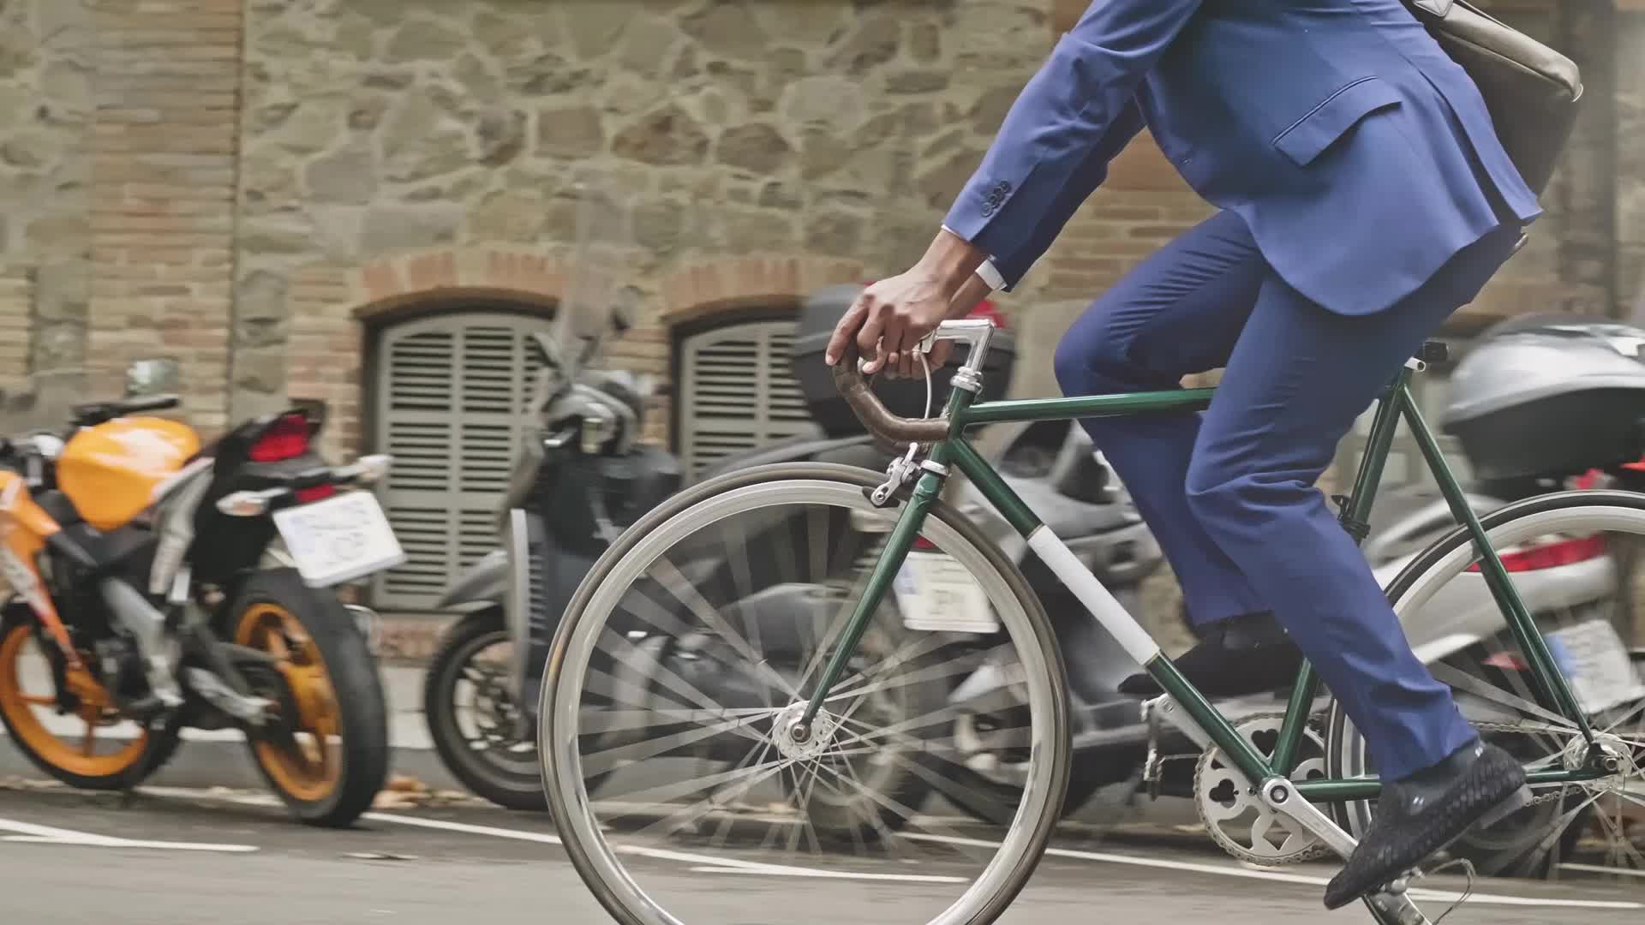
Idea
Smart Bicycle Lock
Motivation: Considering the large number of bicycle users is Louvain-la-Neuve (and generally in Western Europe), it is crucial to ensure the security of one’s bicycle.

Slide 3

Possible Features
Smart locking mechanism (via GPS)
Location tracking
Lock/unlock remotely
CHECK LOCK STATUS ONLINE

Slide 4
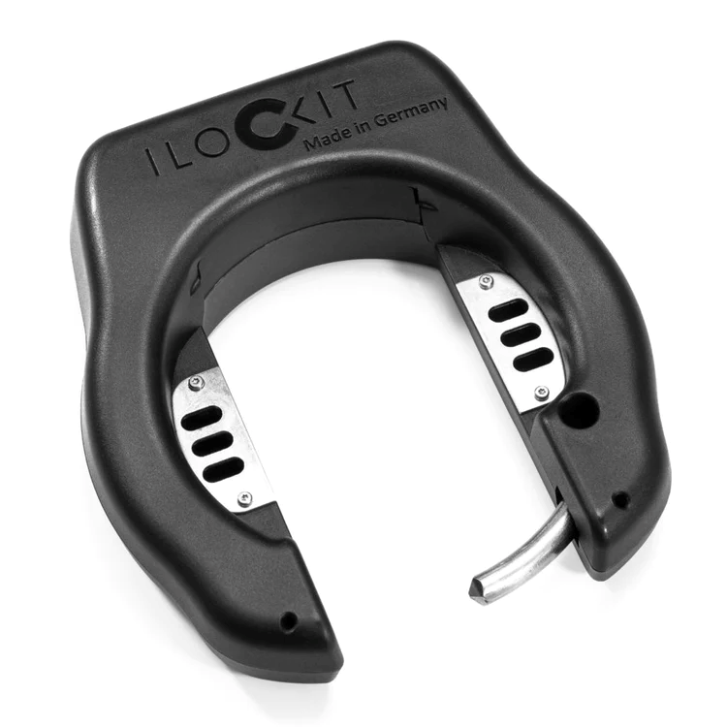
Real Life Example
https://ilockit.bike/en
A German company producing smart bicycle locks similar to what we have in our minds

Slide 5
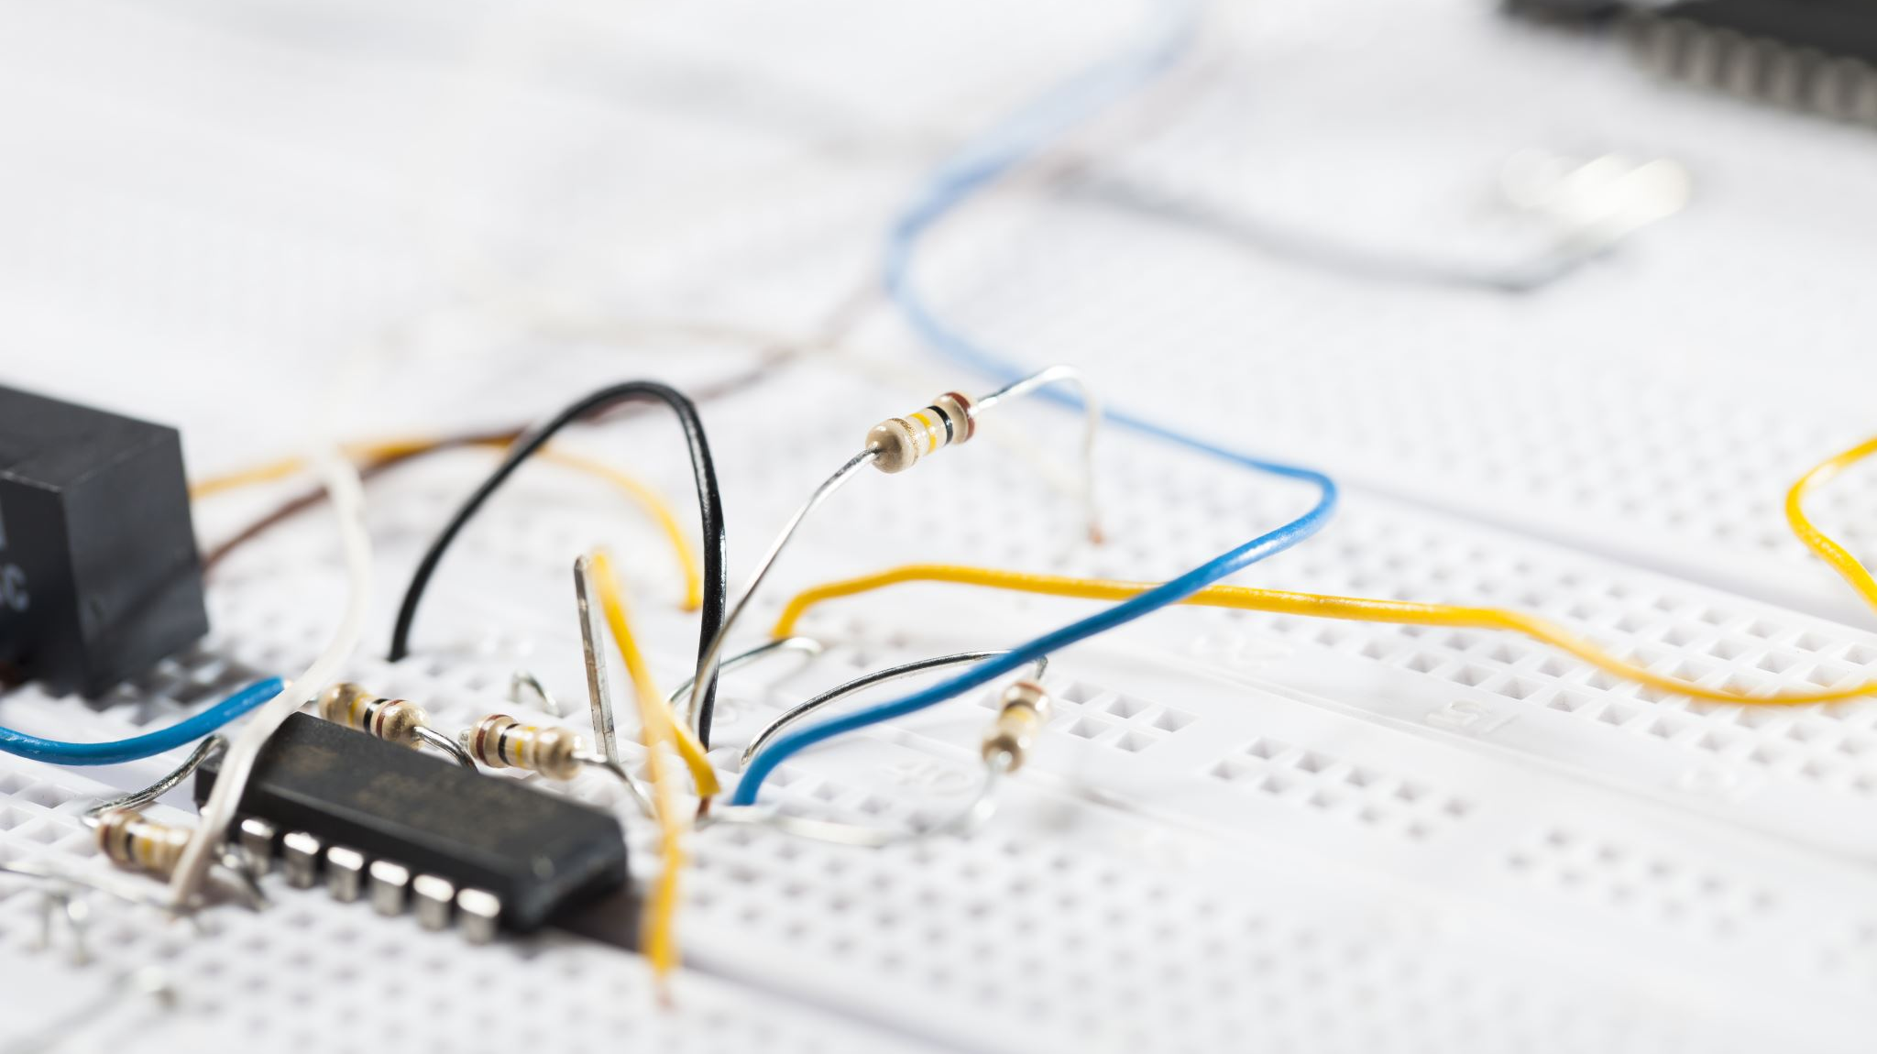
Design
Raspberry Pi (model will be determined once the design is final)
LoRa module
Servo motor or a Push-Pull Solenoid (to physically move the lock)
GPS module
Rechargeable power supply

Slide 6
Available Time Slots
Monday – between 11:00 and 16:00
Tuesday – until 14:00
Wednesday – no common availability
Thursday – after 16:00
Friday – between 11:00 and 14:00

